Slide 1
AUTOMATED ATTENDANCE SYSTEM USING FACE RECOGNITION
Project Supervisor:
Project Members:
Kirupa Shankar K M,
Assistant Professor/CSE,
Government College of Engineering,
Dharmapuri.
Bharanidharan B [613520104004]
Perumal S [613520104021]
Sridhar T [613520104038]
Thennarasu R [613520104041]

Slide 2
INTRODUCTION
Facial recognition is a framework or a software which is capable of verifying the identity of an individual by analyzing a picture or video footage.
Face recognition is a biometric method in which an individual is identified by comparing the real-time capture image with the images stored in that person's database
Face recognition system is very useful in life applications especially in security control systems. The airport protection system uses face recognition to identify suspects and FBI (Federal Bureau of Investigation) uses face recognition for criminal investigations.

Slide 3
Traditional attendance marking technique is often facing a lot of trouble.
Traditional attendance marking technique like name calling is time consuming and insecure.
Thus, face recognition attendance system is proposed in order to replace the manual work and make it automated.

Slide 4
OBJECTIVE
The objective of this project is to develop a face recognition based automated attendance system.
Our system will be capable of detecting the segment of faces from the video frame or a picture , extract the useful features from the detected face , classify the features to recognize the detected face and record the attendance of the detected students.
This system aims to reduce the manual labor used in recording and maintaining the attendance and to reduce the time wastage in traditional attendance system.
Although there are existing automated systems our system aims to improve the efficiency of the image detection and improved time in recognizing faces.

Slide 5
LITERATURE SURVEY
S.No | Title | Author | Abstract | Year
1. | Face Recognition Based Automated Student Attendance System using Deep Learning | P.C.Senthil Mahesh et al. | The system automatically starts taking snaps as the time for the corresponding subject arrives and then applies face detection and recognition technique to the given image and the recognized students are marked as present and their attendance update with the appropriate time and subject Id. | 2020
2. | An improved face recognition algorithm and its application in attendance management system | Fang Ming et al. | a new method using Local Binary Pattern (LBP) algorithm combined with advanced image processing techniques such as Contrast Adjustment, Bilateral Filter, Histogram Equalization and Image Blending to address some of the issues hampering face recognition accuracy. | 2020
3. | Real-Time Smart Attendance System using Face Recognition Techniques | Shreyak Sawhney et al. | model for implementing an automated attendance management system for students of a class by making use of face recognition technique, by using Eigen face values, Principle Component Analysis (PCA) and Convolutional Neural Network (CNN). | 2019

Slide 6
S.No | Title | Author | Abstract | Year
4. | Automated Attendance Marking and Management System by Facial Recognition Using Histogram | Jenif W.S. D'Souza et al. | This proposed system is been implemented with 4 modules such as Image Capturing, Segmentation of group photo and Face Detection, Face comparison and Recognition, Updating of Attendance in database. | 2019
5. | An Image Acquisition Method for Face Recognition and Implementation of an Automatic Attendance System for Events | Luis Fung-Lung et al. | Smart Event Faces Database using ResNet 34 for feature extraction and the next classifiers: K-Nearest Neighbors, Naive Bayes, Random Forest, Multi-Layer Perceptron, Decision Tree, Adaboost and Support Vector Machine. | 2019

Slide 7
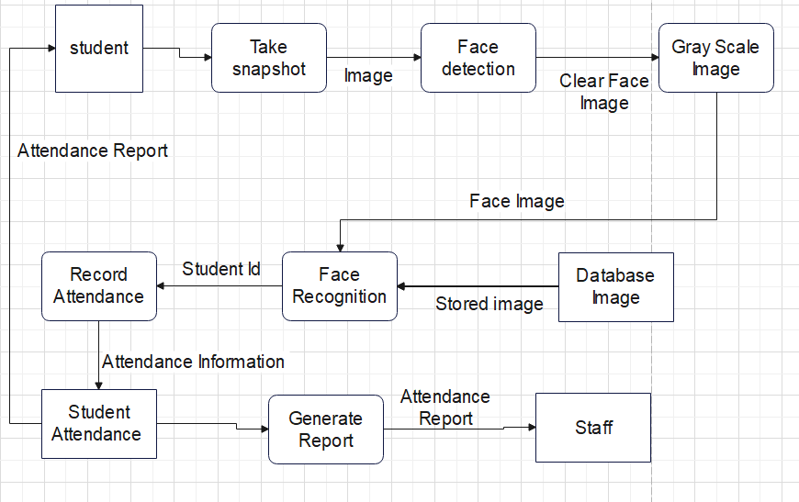
Architecture Diagram

Slide 8
System Specification
Hardware Components
Processor - Intel I5&Above
RAM - 8Gb&Above RAM,64bit
Storage - 100GB
Camera or Webcam accessible system

Slide 9
System Specification
Software Components
Front-End - HTML5,CSS,Python Flask
Tools - PyCharm Studio
Platform - Windows 8 & above

Slide 10
Components
High-resolution cameras
Facial feature extraction
Face matching and identification algorithms
Database for storing and managing student/employee information

Slide 11
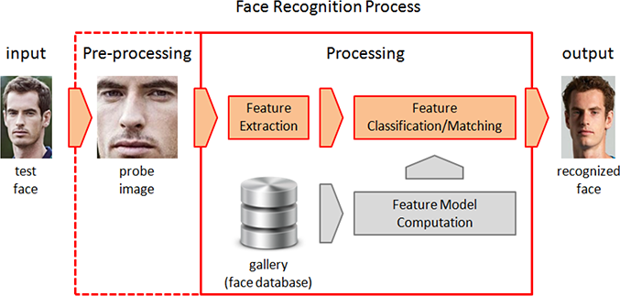
Face Recognition Process

Slide 12
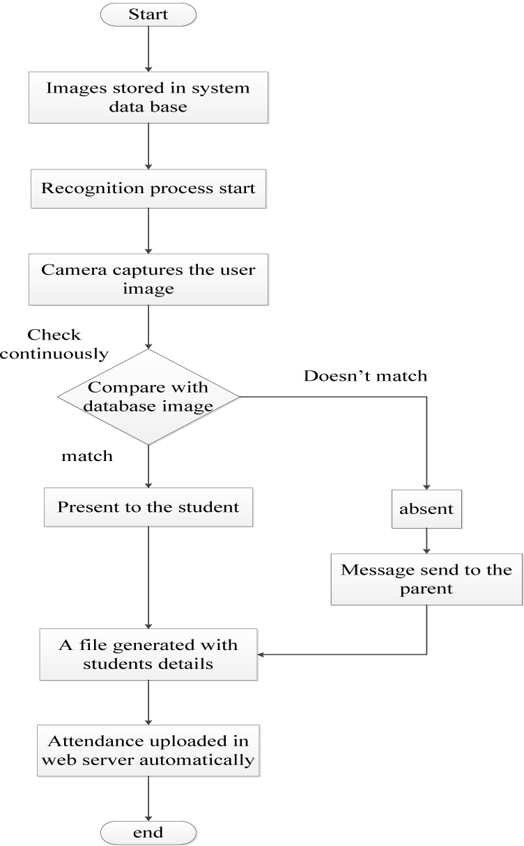
System Workflow

Slide 13
Benefits
Accuracy and reliability
Time-saving and efficiency
Fraud prevention
Contactless operation

Slide 14
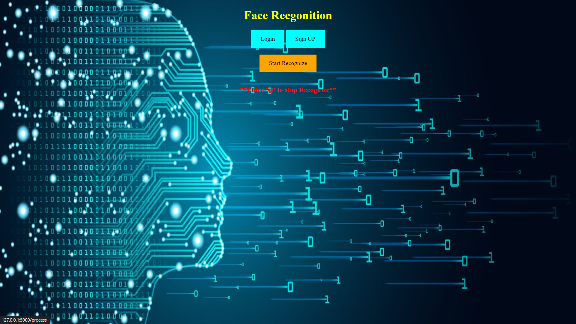
HOME PAGE

Slide 15
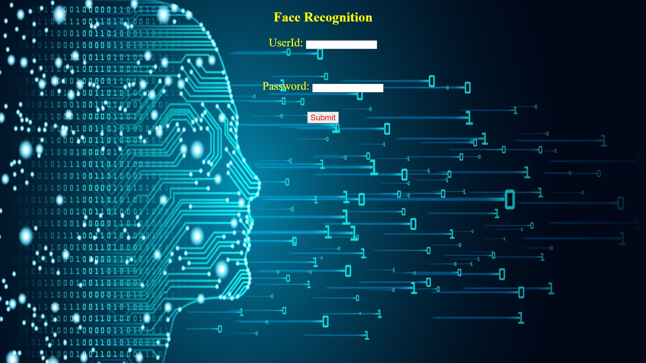
Login to download Attendance List

Slide 16
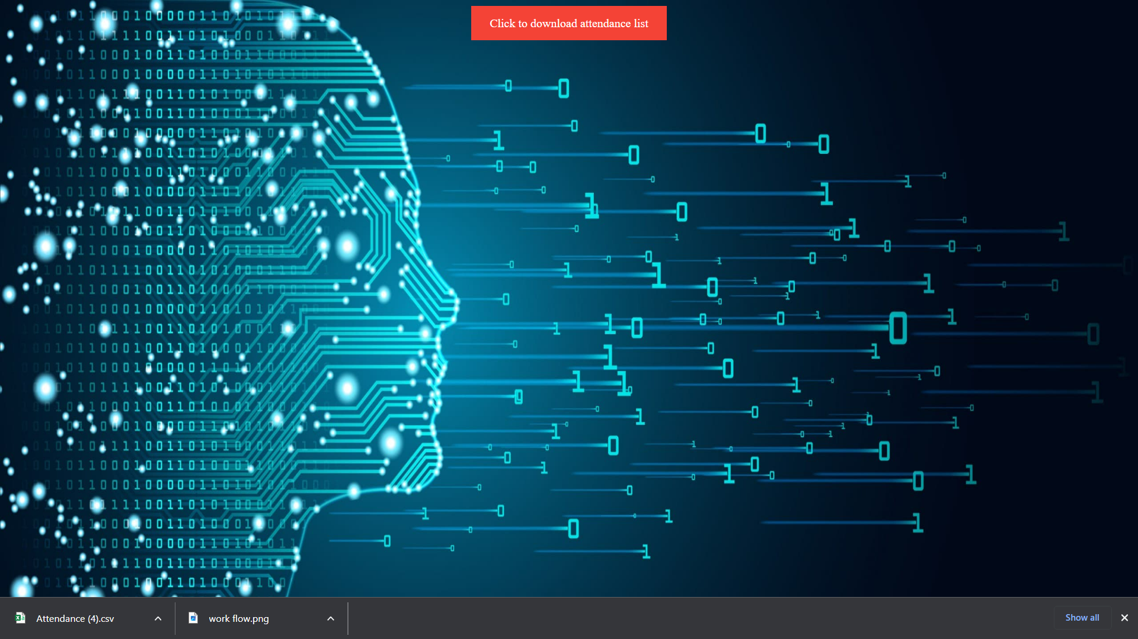
Login to download Attendance List

Slide 17
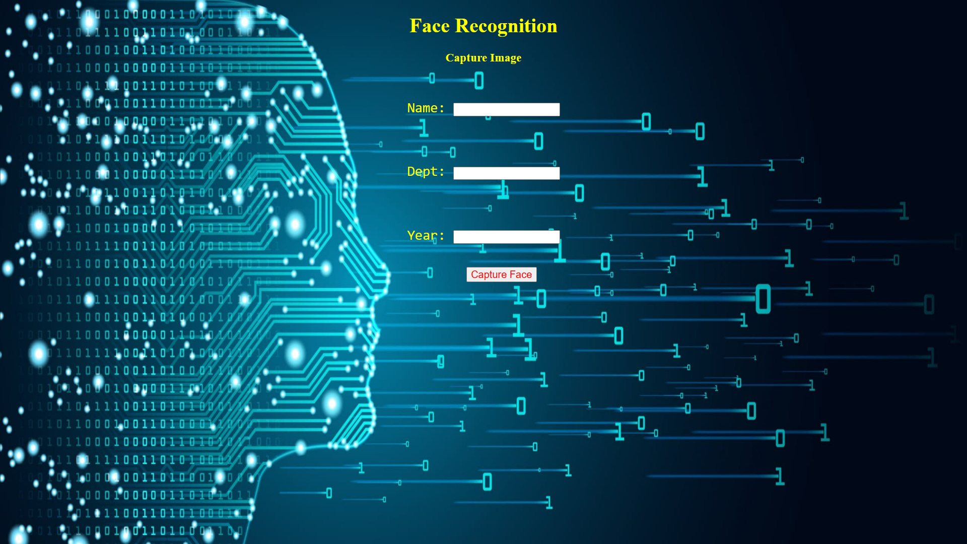
Sign Up Page

Slide 18
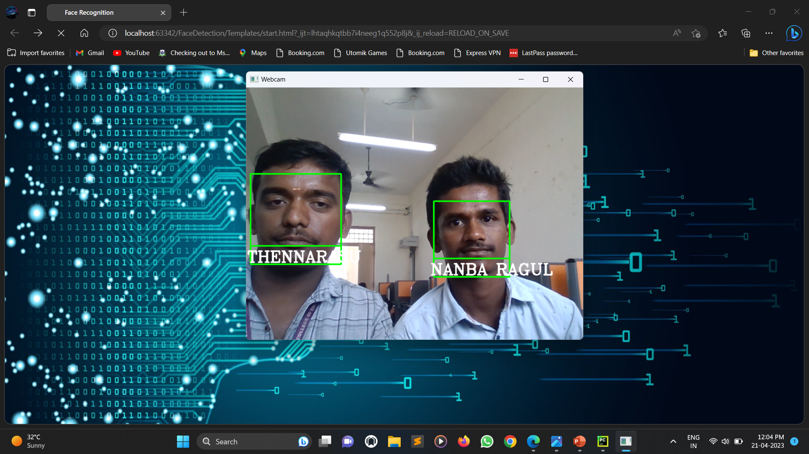
Face Recognition

Slide 19

Attendance Xsl Sheet

Slide 20
THANK YOU

